Slide 1
Bet on Better
Team AUM

Slide 2
Problem Statement
Voice the needs of certain part of the community.
Lack of platforms which bridges the gap between people and the community.

Slide 3
Solution
Build a platform which will enable users to raise financing for their cause at the same time donate for a cause.
People can also create fundraising events to make it more interactive and promising for the donor.

Slide 4
Approach
Created the object model.
Created a basic workflow.
Implemented the workflow.
Created Work Requests.

Slide 5
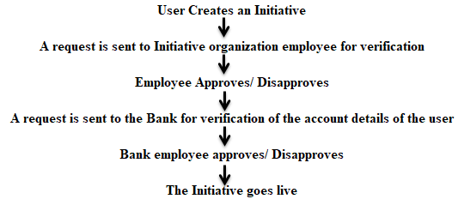
Use case 1
User raises an Initiative.

Slide 6
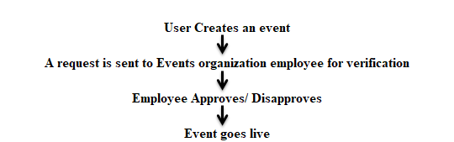
Use case 2
User Creates an Event

Slide 7
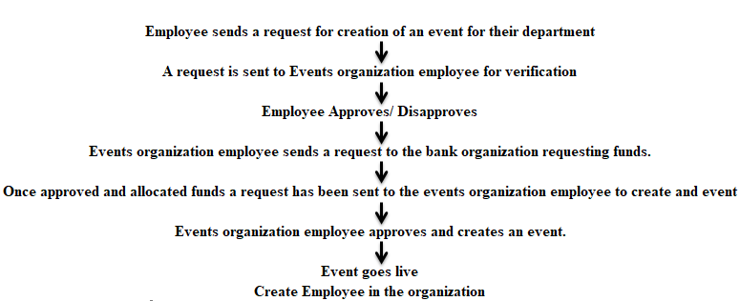
Use case 3
Initiative organization employee requests Events organization employee to create an event

Slide 8
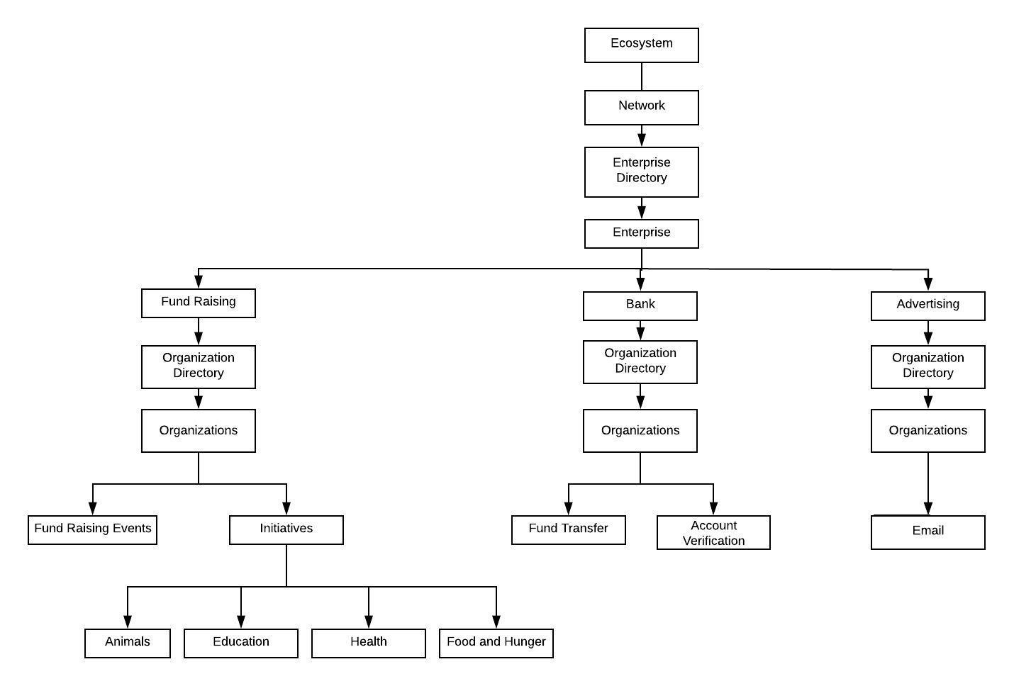
Object model

Slide 9
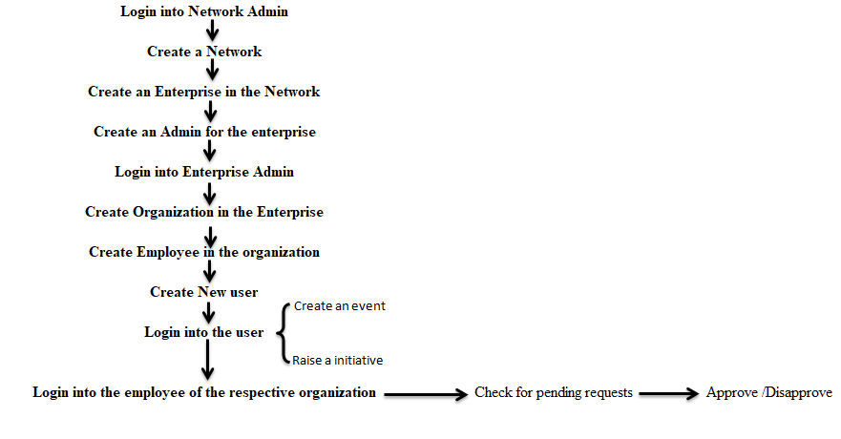
Work flow

Slide 10
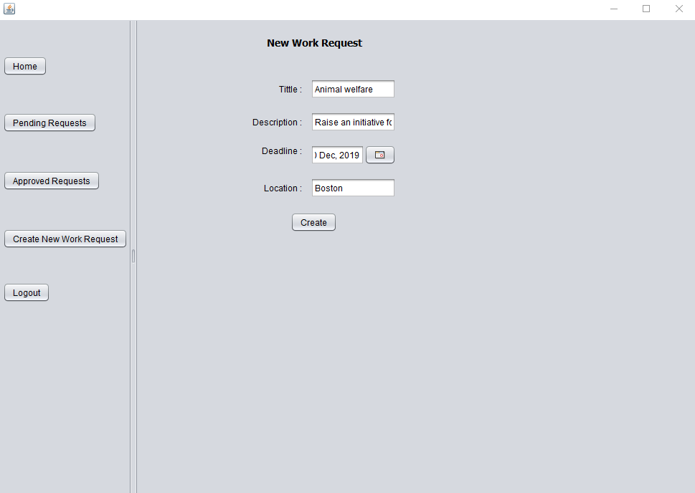

Slide 11
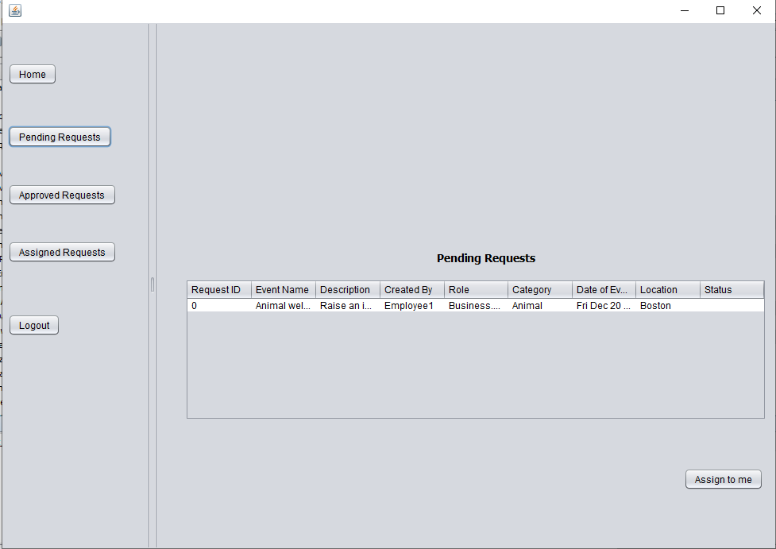

Slide 12
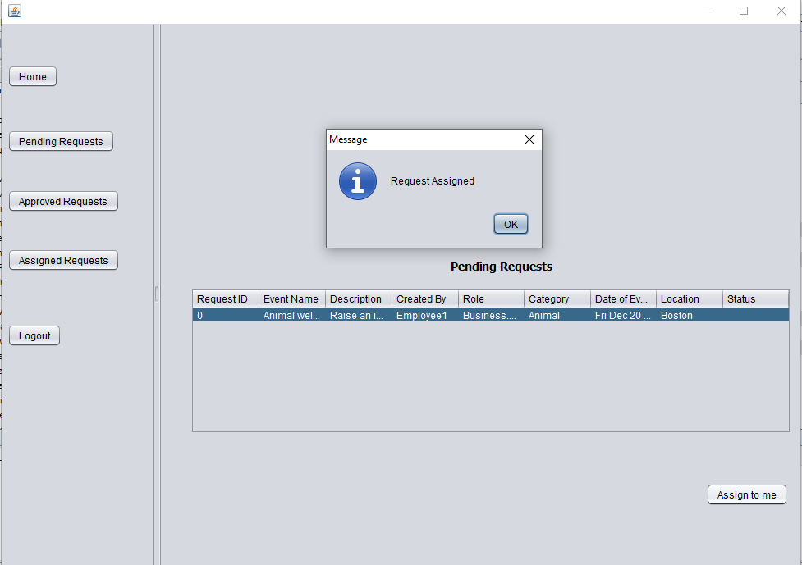

Slide 13
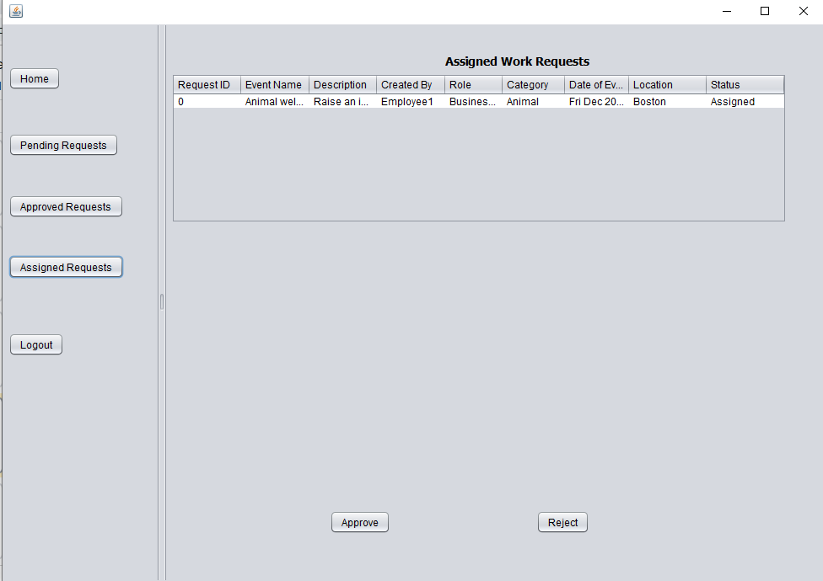

Slide 14
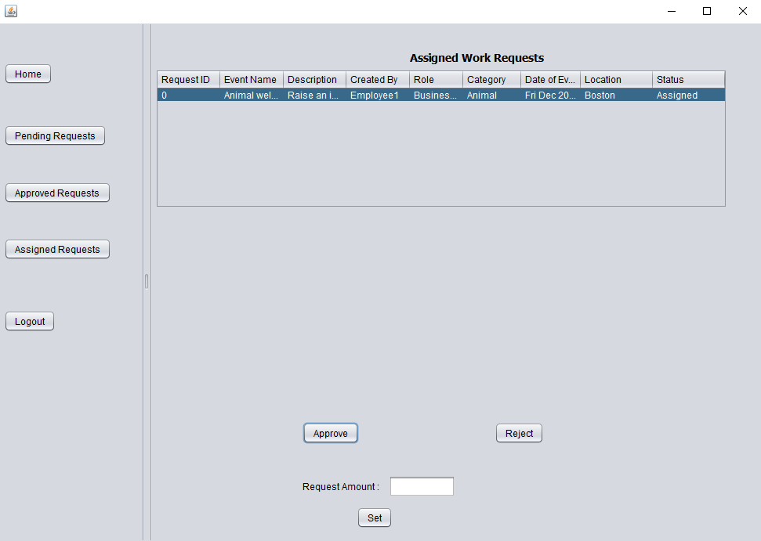

Slide 15


Slide 16
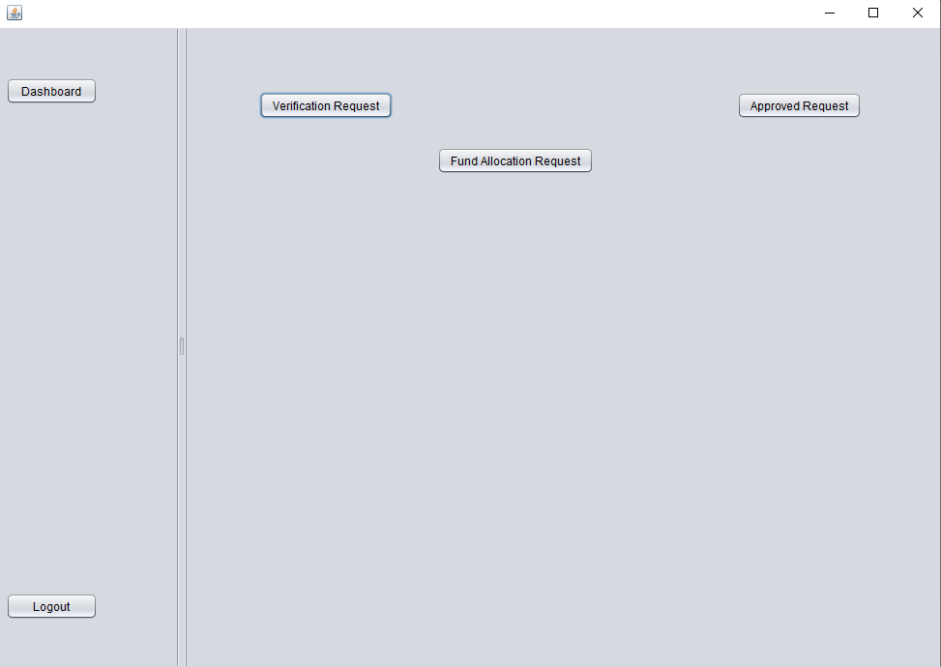

Slide 17
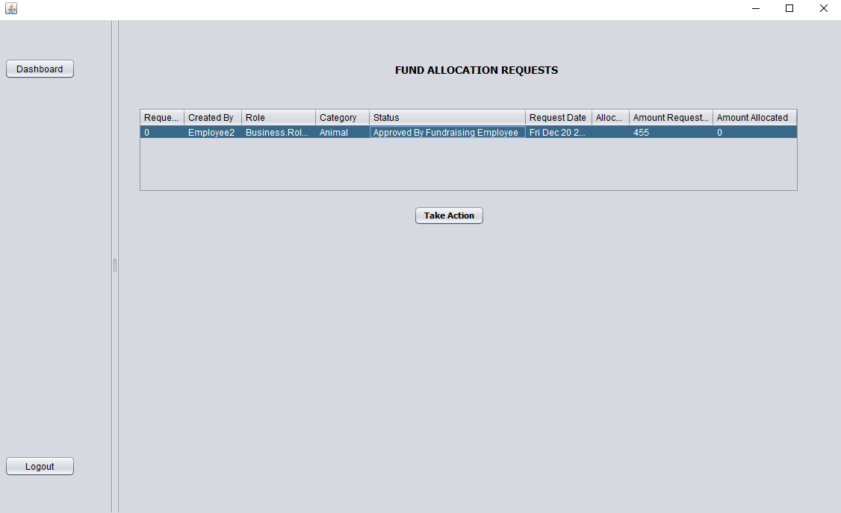
Key screenshot e.g. important use case

Slide 18
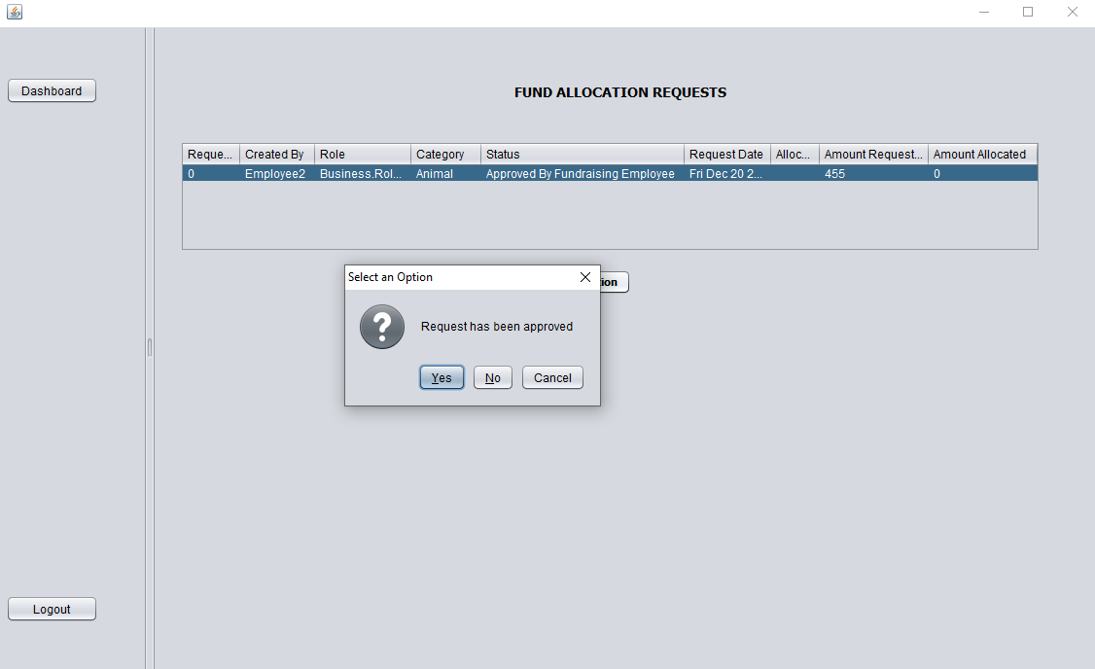

Slide 19
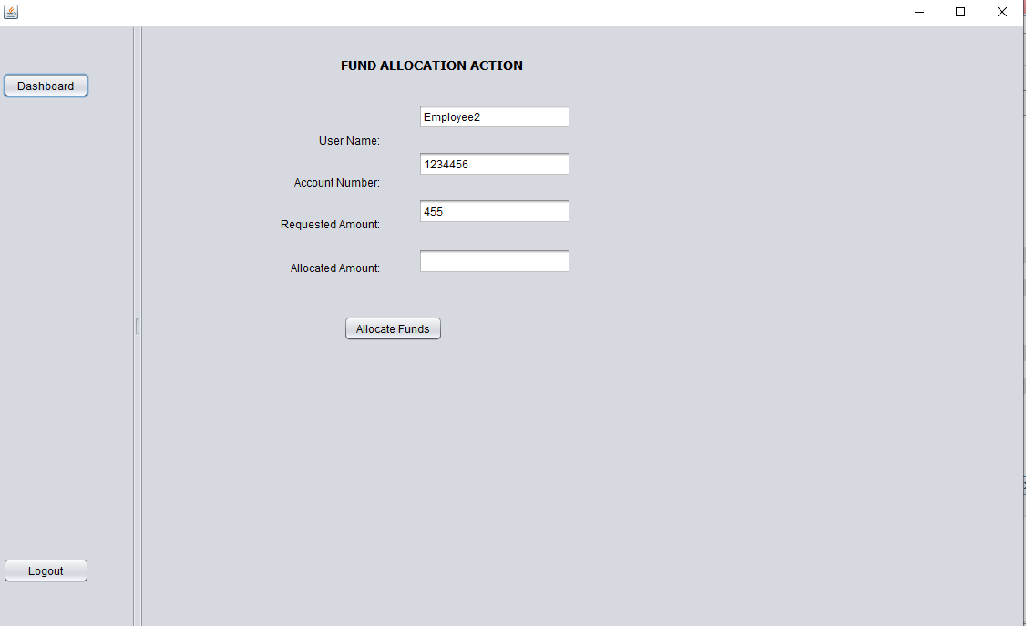

Slide 20
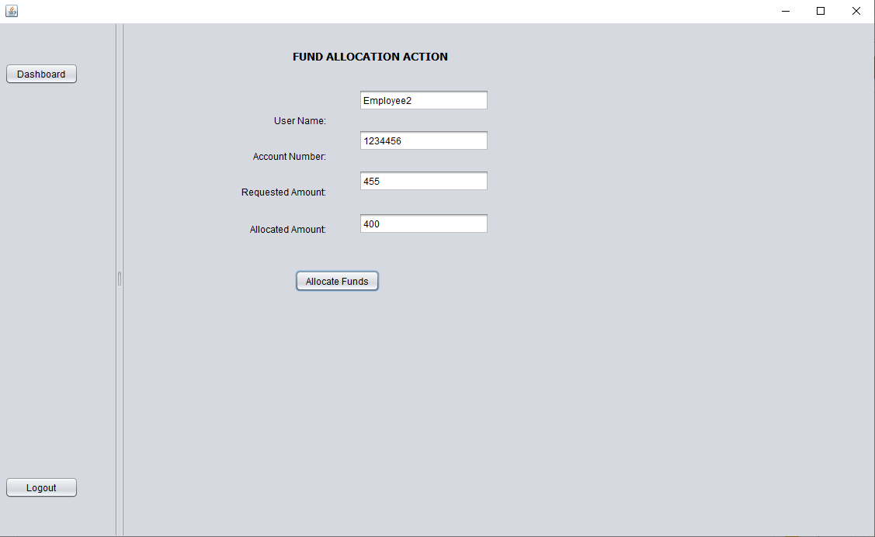

Slide 21
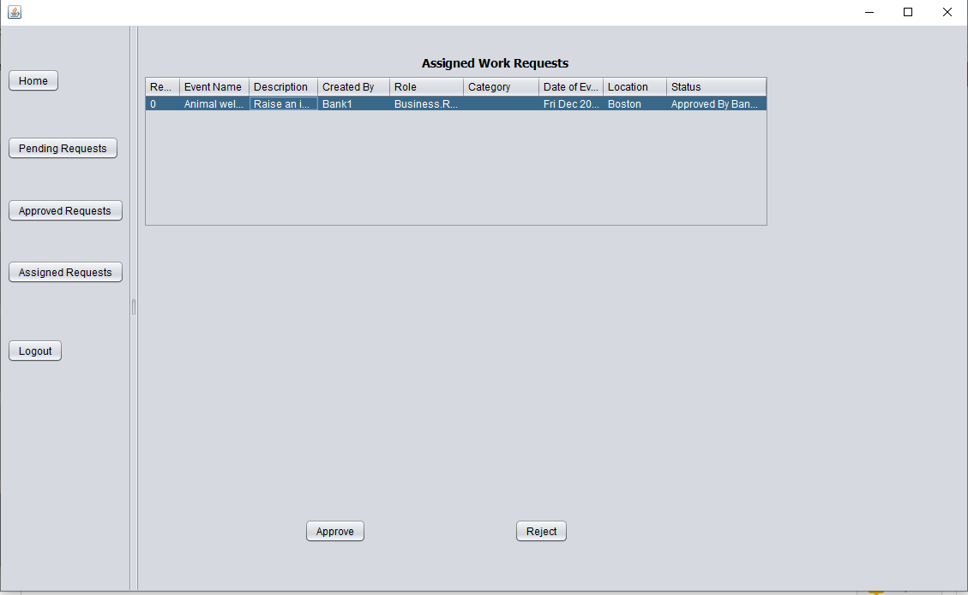

Slide 22
THANK YOU!

